Slide 1
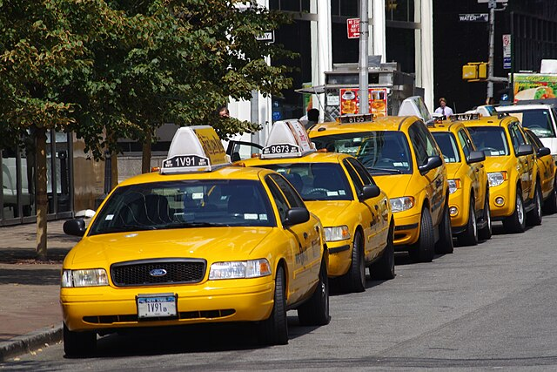
NYC Taxi

Slide 2
Project analysis slide 2
Content
Overview
Dataset Summary
Data Profile
Architecture Tool Blueprint and Final Arch
Demo And Analysis
Project RACI

Slide 3

Project analysis slide 2
Project Overview
Objective
To construct a comprehensive data warehouse and business intelligence solution utilizing AWS.
We are focusing on the "Yellow Taxi Trip Data" from NYC Open Data.
Intention is to leverage the wealth of information in this dataset to unearth valuable insights into the dynamics of New York City's transportation system
Datasets
"2021 Yellow Taxi Trip Data" from NYC Open Data. (Via API call in JSON format)
NYC Taxi Zones from Data Gov. (csv file: structured data)

Slide 4


Project analysis slide 2
Project Overview
Insights
Identify peak taxi usage times
Determine the average fare and tip amounts
Uncover geographic hotspots for taxi pick-ups and drop-offs
Observe temporal trends in taxi usage
Goal
Enhance taxi dispatch efficiency, provide valuable data for policy-makers and urban planners, and contribute to a more thorough understanding of urban mobility patterns in New York City.

Slide 5
Project analysis slide 2
Dataset Summary
Attributes
Dataset | 2021 Yellow Taxi Trip Data | NYC Taxi Zones
Source | NYC Open Data | Data Gov
Descriptions | These records, submitted by yellow taxi Technology Service Providers (TSPs), each represent a single yellow taxi trip in 2020. They include details like dates/times, locations, distances, fares, rate and payment types, and passenger counts for each trip. | This dataset displays NYC Taxi Zones, aligning with pickup and drop-off LocationIDs in the Yellow, Green, and FHV Trip Records available on Open Data. These zones, based on the NYC Department of City Planning’s Neighborhood Tabulation Areas (NTAs), approximate neighborhoods, showing the pickup and drop-off neighborhoods for passengers.
Rows & Columns | 30.9M rows & 18 Columns | 263 rows & 7 Columns
Access | via NYC Open Data API | via CSV file
Data Quality | • Clean, well-maintained, clear schema, and consistent data types • Data Profiling required | • Clean, well-maintained, clear schema, and consistent data types • Data Profiling required

Slide 6















Project analysis slide 3
Data Pipeline
AWS Glue
Files/Documents
S3
Data Source
Collection
Processing
Storage
Consumption
Batch
&
Streaming Data
Data Ingestion
Validation, Clearing & Transformation
Data Warehouse / Data Lakes
Analytics
&
Business Insights

Slide 7
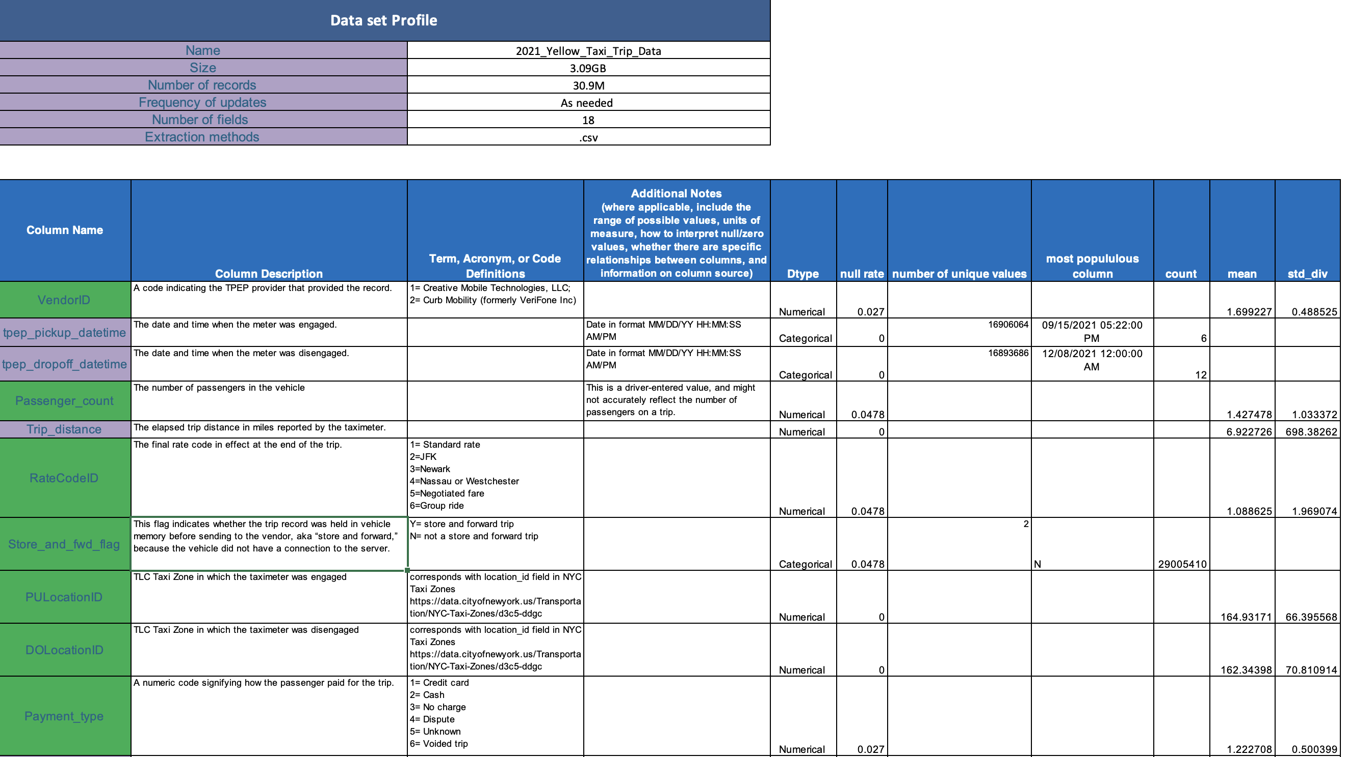

Project analysis slide 2
Dataset Profiling
Profiling
Data Profiling Files

Slide 8
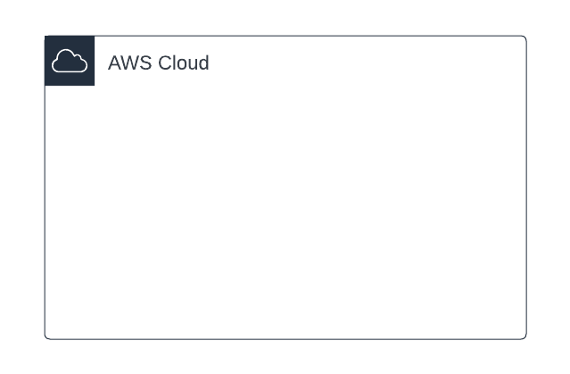



Project analysis slide 4
Proposed Architecture Tool Blueprint
AWS Glue
Lambda
function
S3
S3
Files/Documents
Landing
zone
Transformed
data
BI Tool
Note: Architecture may have a slight change as moving forward with the project.

Slide 9
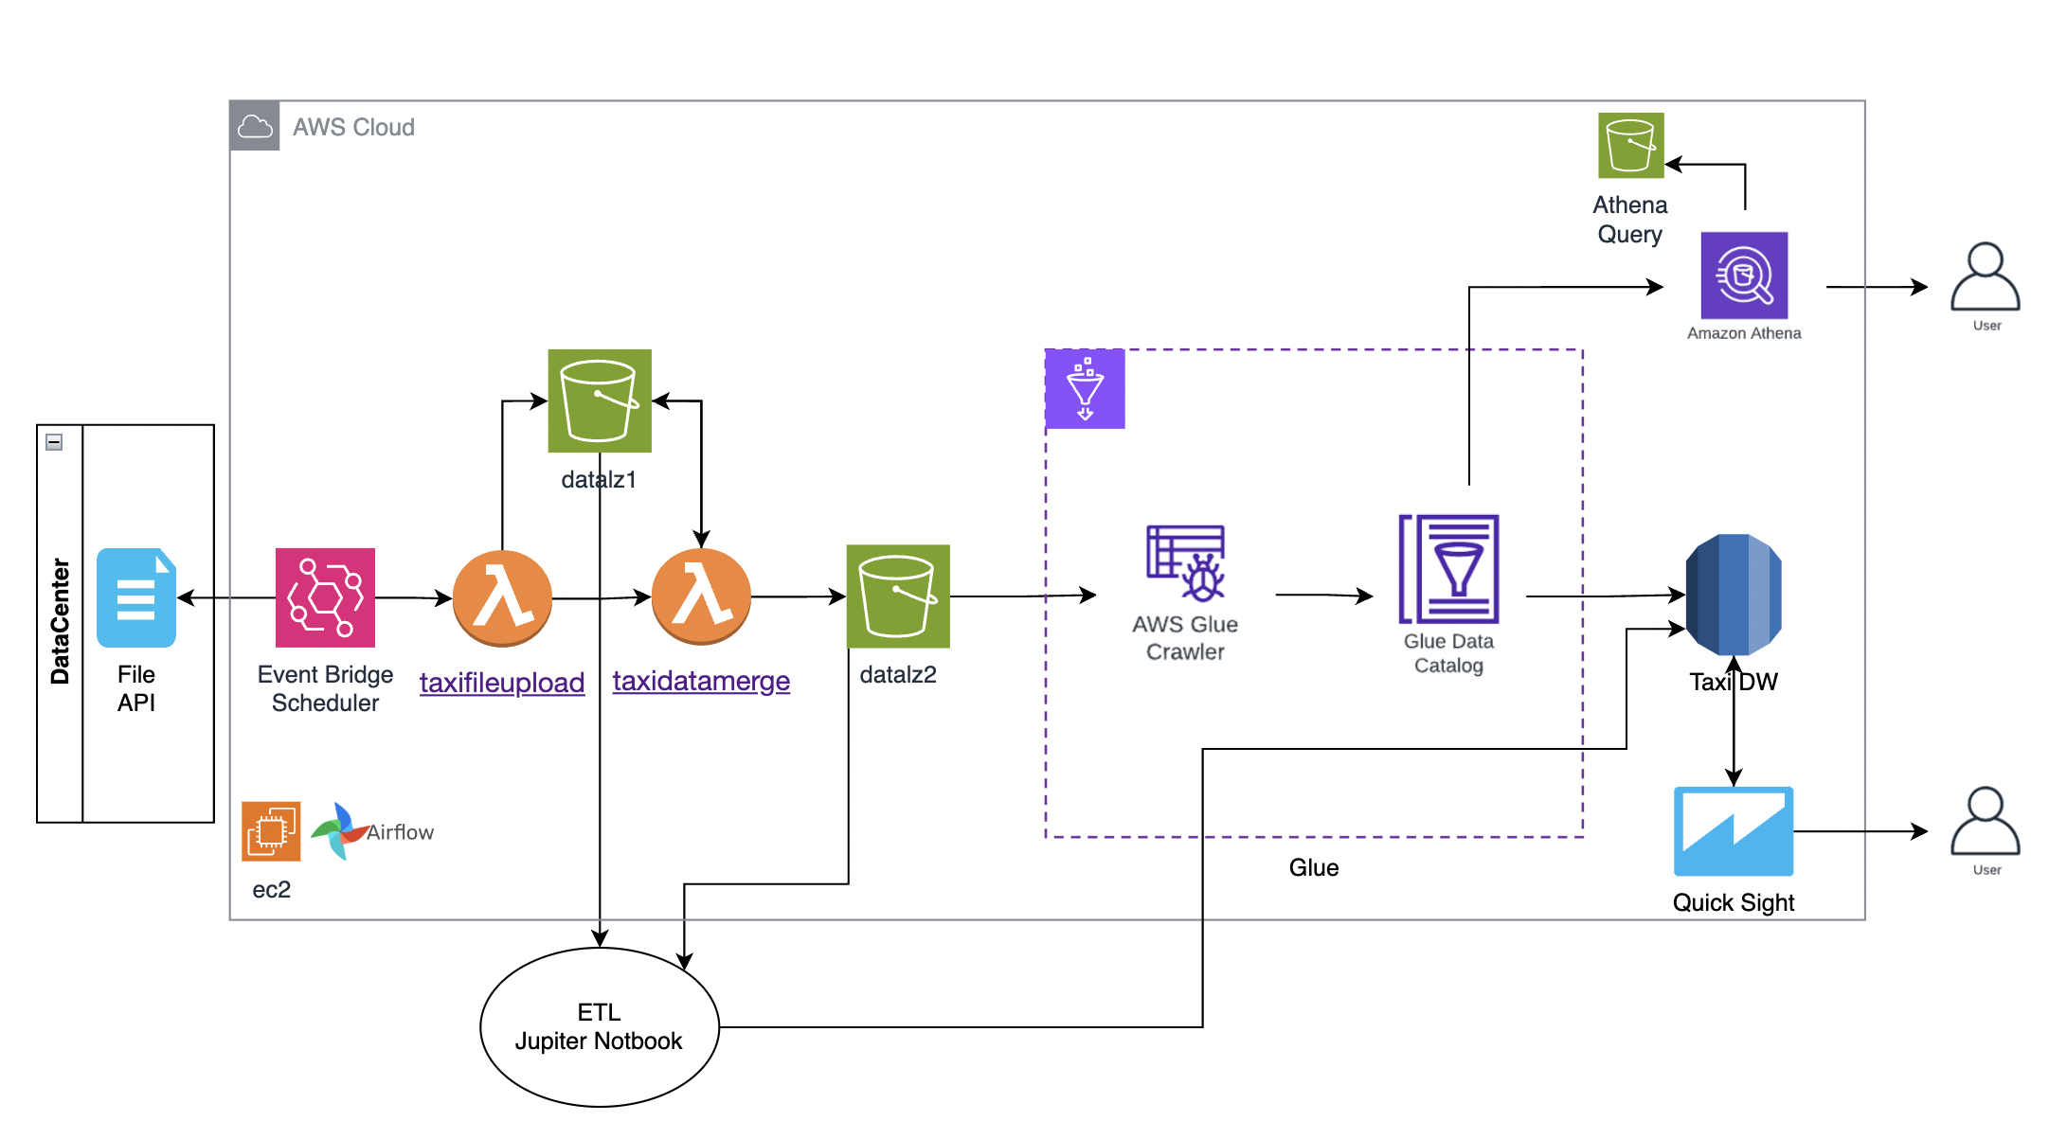
Project analysis slide 4
Final Architecture

Slide 10
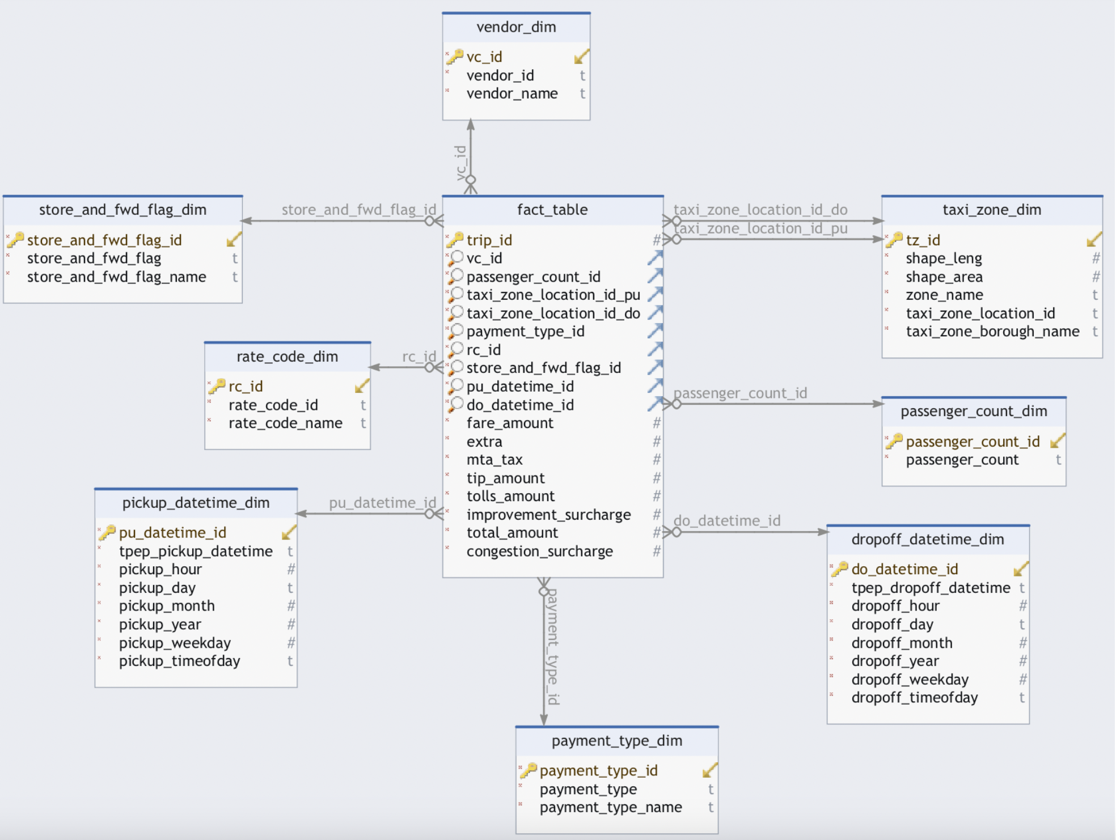
Project analysis slide 4
Data Model
Fact Table
fact_table
Dimension Tables
vender_dim
rate_code_dim
taxi_zone_dim
Payment_type_dim
Dropoff_datetime_dim
Pickup_datetime_dim
store_and_fwd_flag_dim
Passenger_count_dim

Slide 11
Project analysis slide 2
Architecture Explained
Architecture Explained

Slide 12
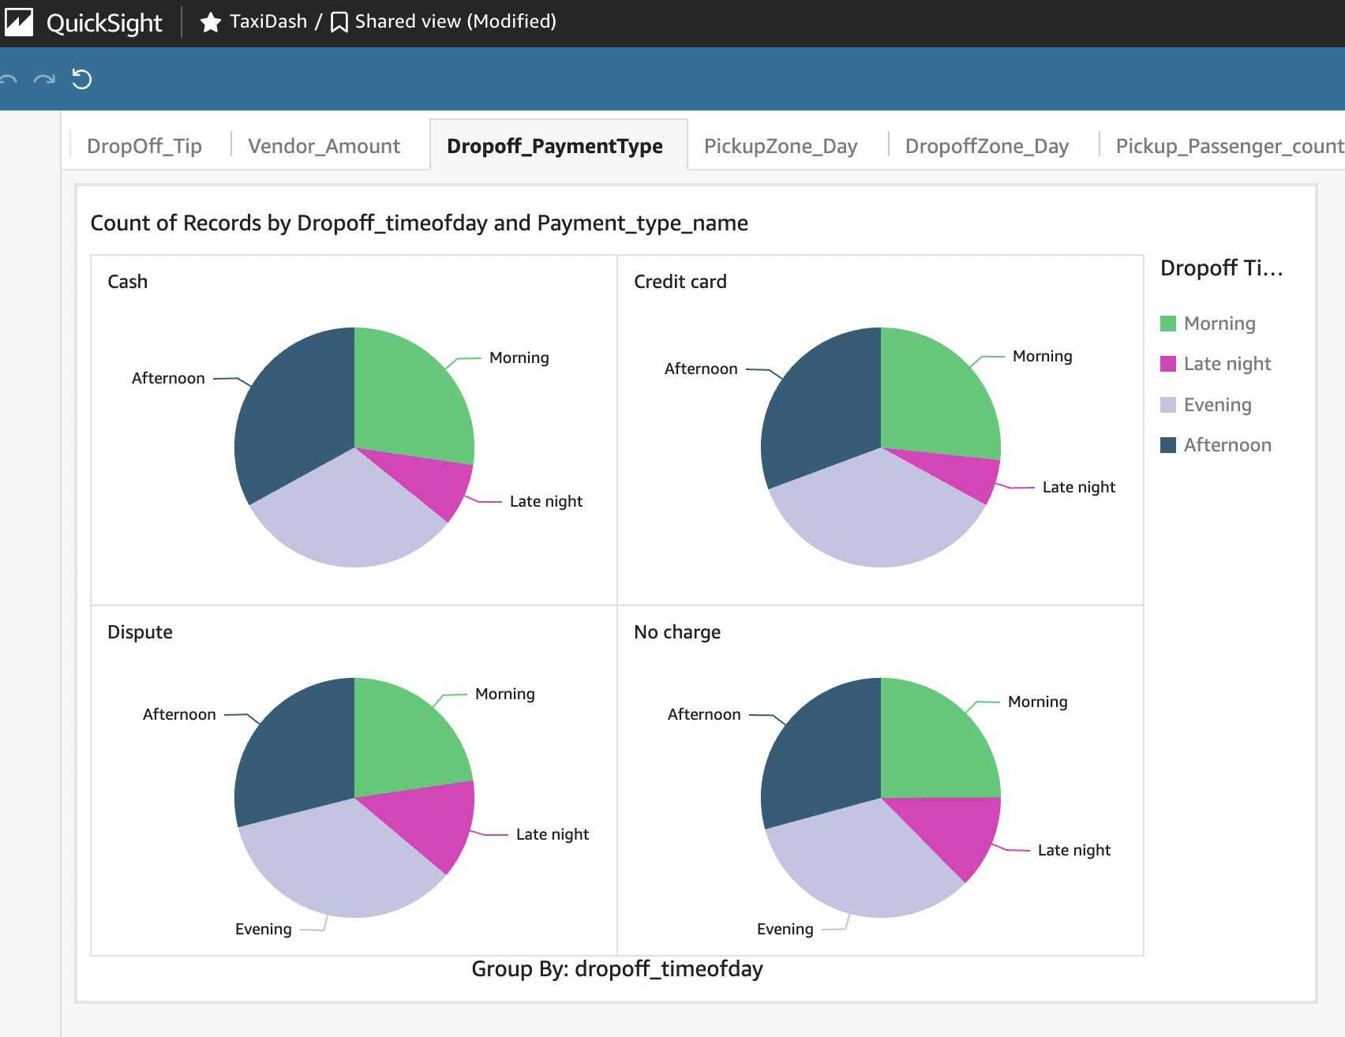
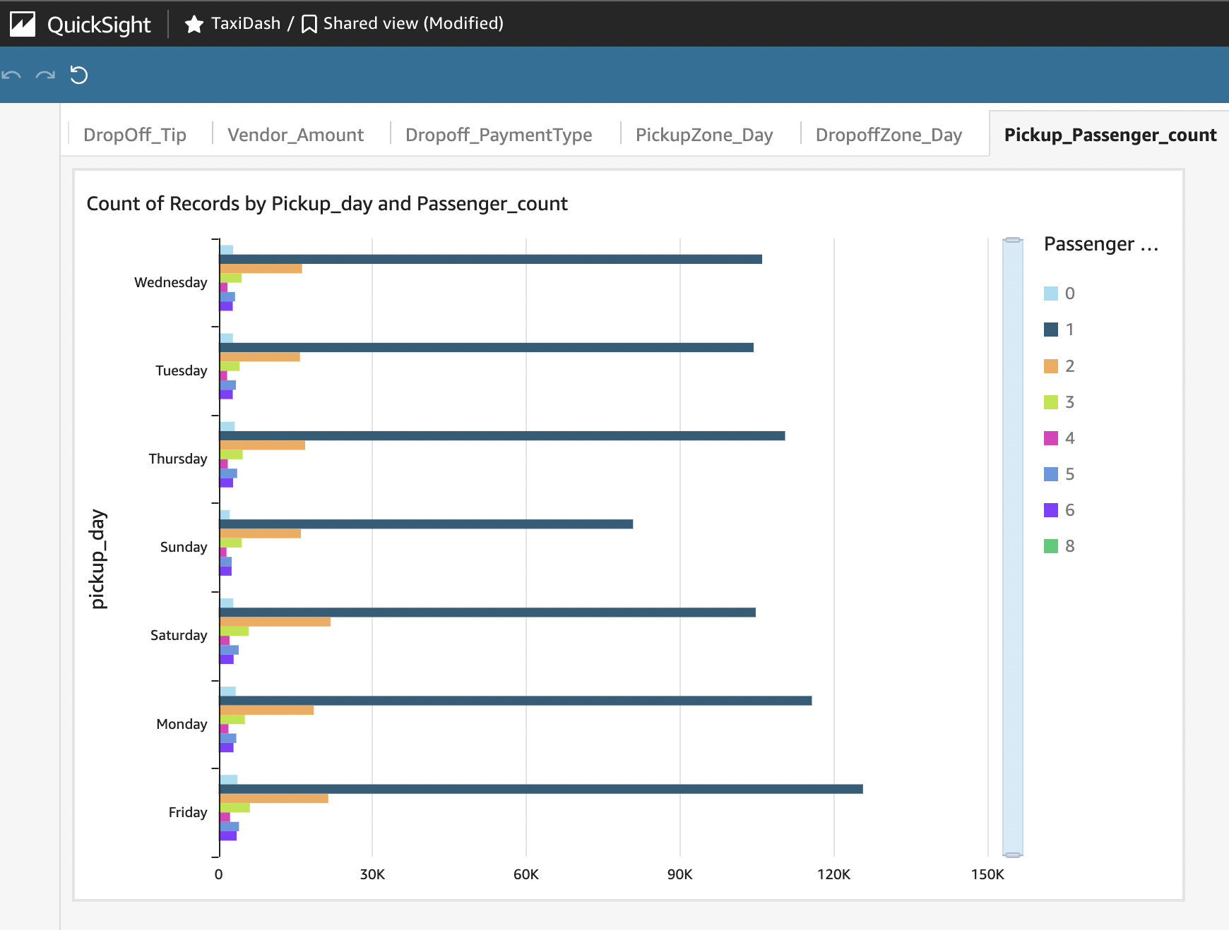
Project analysis slide 2
Analytics & Dashboard
3. Design &
Development
AWS Quicksight
LINK
Tip Amount of Dropoff
What is the average tip amount for trips dropped off at each taxi zone?
Total Amount by Vendor Name
What is the total revenue generated by each vendor based on the trips they've serviced?
Max Payment Type
Which payment type is most frequently used for settling taxi fares?
Max Pickup Zone for Pickup Day Time
Which pickup zone has the highest number of pickups during the daytime?
Max Dropoff Zone for Dropoff Time
Which dropoff zone has the highest number of dropoffs at a particular time of day?
Passenger Count by Pickup
What is the average number of passengers per trip for each pickup zone?
Maximum Pick Zone by Borough
Which borough has the pickup zone with the highest number of trips?
MTA Tax on Borough
How much MTA tax is collected on average for trips within each borough?
Rate Code by Borough
What is the most common rate code used for trips in each borough?
Toll Tax by Borough
What is the total toll tax collected from trips in each borough?

Slide 13
Project analysis slide 2
Project Future Scope
Future Scope
Of the project
New Glue clawer will be setup to transfer the transformed files between buckets.
SCD type 2 or type 3 will be setup to the Data Model.
AWS Kinesis can be setup for continues ingestion of the data.
Airflow can be setup for continues monitoring of the job.

Slide 14
Thank You

